Slide 2
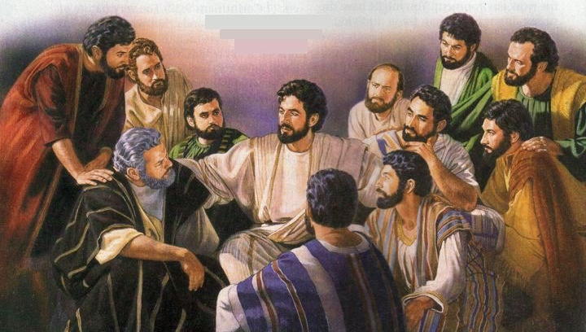
Mark 16:15-16 - “Go into all the world and preach the gospel to every creature.”

Slide 3
Want to be more active and effective in personal evangelism?
Set goals
Study with at least 5 people this year who are in need of the truth.
Make known to them what they most need to hear to make it to heaven.

Slide 4
Want to be more active and effective in personal evangelism?
Set goals
Pray for opportunities (Matthew 7:7-8)
Study your Bible everyday (1 Peter 3:15)

Slide 5
Want to be more active and effective in personal evangelism?
Set goals
Pray for opportunities (Matthew 7:7-8)
Study your Bible everyday (1 Peter 3:15)
Reserve one night a week for evangelism
Have a study with someone who is lost
Try to set up a study with someone lost
Prepare yourself for a study with someone lost

Slide 6
Want to be more active and effective in personal evangelism?
Set goals
Pray for opportunities (Matthew 7:7-8)
Study your Bible everyday (1 Peter 3:15)
Reserve one night a week for evangelism
Live each day as if it were your last
If this was your last opportunity to talk to these people, what would you talk about?

Slide 7
Broaching the Subject
If we want to teach the lost, we will have to break out of our comfort zone and talk to them about spiritual things.
Inviting them to church, while good, is not a very effective means of teaching them the truth.
The most effective means is one-on-one discussions using the Bible.

Slide 8
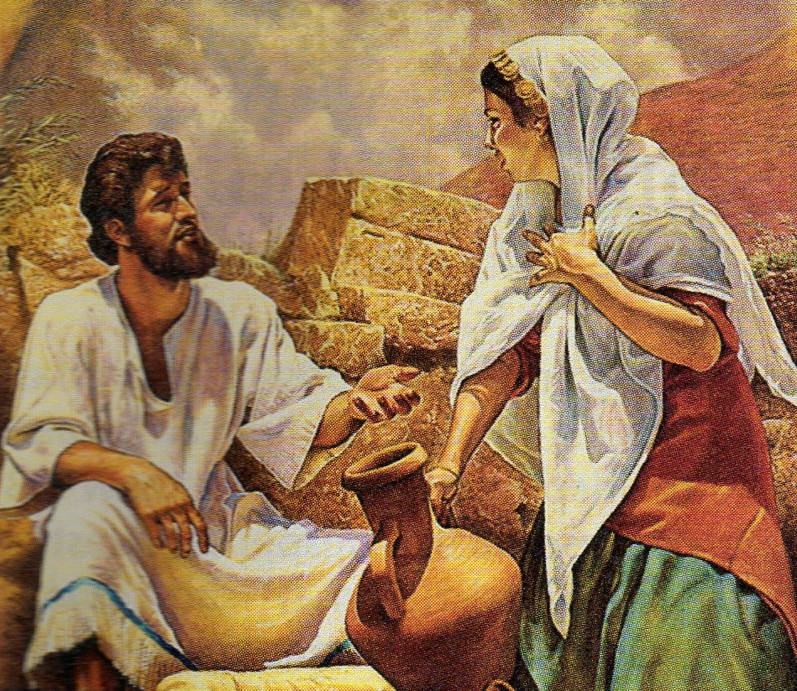
Broaching the Subject
Turning everyday encounters into spiritual discussions (John 4:5-26)
Can’t be afraid of discussing spiritual things
Must be looking to direct the conversation to a needed spiritual lesson (Luke 12:13-15; 13:1-5; Matthew 24:1-2)

Slide 9
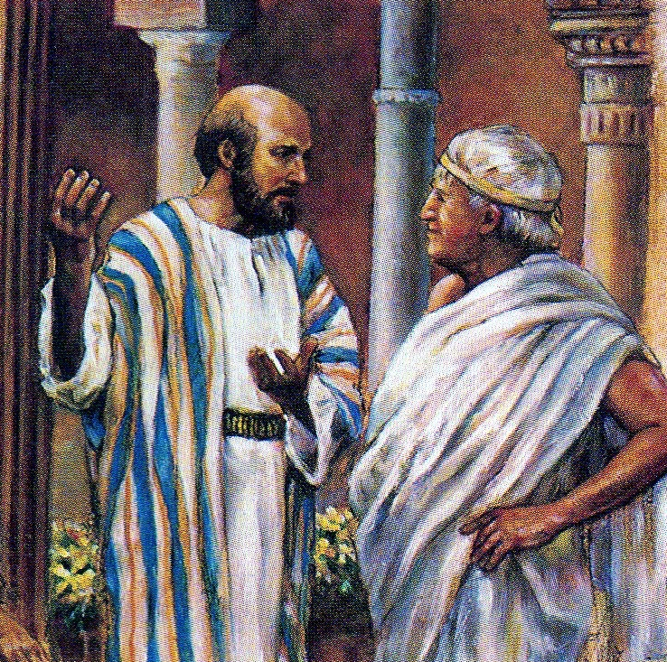
Broaching the Subject
Just start a spiritual conversation based upon what you know about the person’s beliefs (Acts 17:22-23)
Note the obvious and build from there.
Doesn’t hurt to start with a compliment or something you have in common

Slide 10
Broaching the Subject
Other Tips:
A question is sometimes a good way to start a spiritual discussion (Matthew 22:41-45)
Writing a letter or e-mail gives you time to word your thoughts carefully.
When you ask someone to study with you suggest a specific time and place.

Slide 11
Broaching the Subject
What if you make a genuine attempt and they make it clear they are not interested?
We don’t need to spend a lot of time with people who are not interested (Matthew 10:13-14; 7:6)
There are others who are spiritually minded and are willing to sit down and study to find the truth.

