Slide 2
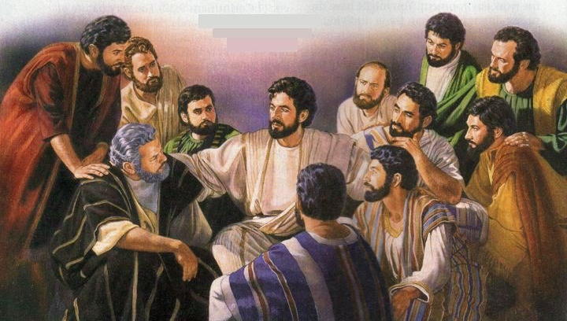
Mark 16:15-16 - “Go into all the world and preach the gospel to every creature.”

Slide 3
Our Credibility with the Lost
Matthew 7:3-5 - “Why do you look at the speck in your brother’s eye, but do not consider the plank in your own eye? Or how can you say to your brother, ‘Let me remove the speck from your eye’; and look, a plank is in your own eye? Hypocrite!”
1 Peter 2:11-12 - “Beloved, I beg you... have your conduct honorable among the Gentiles, that... they may, by your good works which they observe, glorify God in the day of visitation.”

Slide 4
Our Credibility with the Lost
Our Individual Credibility
Personal evangelism is effective because those teaching have credibility with those being taught.
People take note of our morals and priorities long before we start talking to them about the gospel.

Slide 5
Our Credibility with the Lost
Our Individual Credibility
Credibility at home
Credibility at work
Credibility at school
Credibility in the neighborhood
Credibility in the community
1 Peter 2:11-12 - “I beg you... have your conduct honorable among the Gentiles...”

Slide 6
Our Credibility with the Lost
Our Individual Credibility
Do you speak of spiritual things in a way to destroy your credibility?
Are you critical of the church to those outside?
Do you complain about serving the Lord? (Philippians 2:14-16)
Are you apologetic for the truth? (Romans 1:16; 1 Peter 3:15)

Slide 7
Our Credibility with the Lost
Our Collective Credibility
What visitors see in our assemblies affects our credibility (1 Corinthians 14:23-25)
Our attendance
Our behavior during services
Our enthusiasm during services

Slide 8
Our Credibility with the Lost
Our Collective Credibility
What visitors see in our assemblies affects our credibility (1 Corinthians 14:23-25)
Our Doctrine and Practice
Biblical organization
Authorized worship
Scriptural discipline (1 Corinthians 5:1-2)
Following God’s instructions will not drive those people away who are seeking truth. It draws them!

Slide 9
Our Credibility with the Lost
Our faith is on display all the time.
1 Peter 4:4 - “They think it strange that you do not run with them in the same flood of dissipation...”
Matthew 5:13-16 - “You are the salt of the earth... You are the light of the world. A city that is set on a hill cannot be hidden... Let your light so shine before men, that they may see your good works and glorify your Father in heaven.”
Our distinct faith and conduct is our credibility with those that seek truth.

Slide 10
Our Credibility with the Lost
Matthew 7:3-5 - “Why do you look at the speck in your brother’s eye, but do not consider the plank in your own eye? Or how can you say to your brother, ‘Let me remove the speck from your eye’; and look, a plank is in your own eye? Hypocrite!”
(v.5) “First remove the plank from your own eye, and then you will see clearly to remove the speck from your brother’s eye.”

