Slide 2
“The harvest truly is plentiful, but the laborers are few. Therefore pray the Lord of the harvest to send out laborers into His harvest.” (Matthew 9:37-38)
“And he who reaps receives wages, and gathers fruit for eternal life...” (John 4:36)

Slide 3
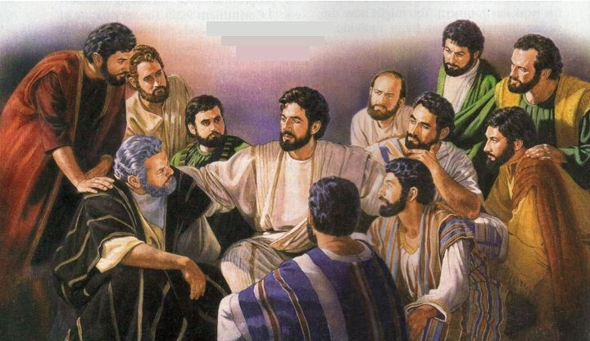
Matthew 10:16-39

Slide 4
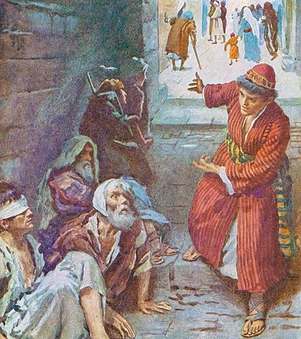
Luke 14:15-23
(vs.16-17) We are the servants that
have been sent to call to those
invited
(vs.18-20) The majority of those invited will make excuses and reject the invitation
Only 8 out of the whole world in Noah’s day (Genesis 6-9)
Only 7,000 out of several million in Elijah’s day (1 Kings 19:18)
Only 3,000 out of 1.5 million on Pentecost (Acts 2:41)
Matthew 7:14 - “Because narrow is the gate and difficult is the way which leads to life, and there are few who find it.”

Slide 5
Luke 14:15-23
(vs.16-17) We are the servants that
have been sent to call to those
invited
(vs.18-20) The majority of those invited will make excuses and reject the invitation
(vs.21-23) So we keep looking for those who will receive God’s invitation

Slide 6
The Risk of Personal Evangelism Matthew 10
(v.22) - “You will be hated by all for My name’s sake.”
(vs.34-36) - “Do not think that I came to bring peace on earth. I did not come to bring peace but a sword...”
(vs.24-25) - “A disciple is not above his teacher, nor a servant above his master... If they called the master of the house Beelzebub, how much more will they call those of his household!”

Slide 7
What is Success and What is Failure? Ezekiel 3:17-19
Successful evangelism is teaching the truth in a way people can know God’s will - regardless if they accept it or reject it (Matthew 10:32)
Unsuccessful evangelism is when we fail to tell people what they most need to hear.
When we fail to speak because we are afraid to risk a relationship (Matthew 10:37-38)
When we are silent because we do not want to be rejected (Mark 8:38)

Slide 8
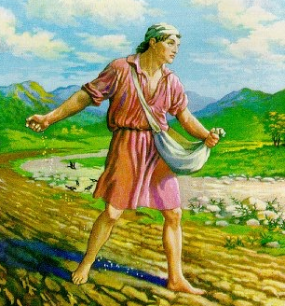
What We Can Expect Matthew 13:3-9, 19-23
(v.19) Many will not understand the significance of what they hear.
(vs.20-21) Other will respond, but only continue in the truth for a short time.
(v.22) Others will respond and look promising, but will get too caught up in worldly things.
(v.23) But there will be a few who allow the gospel to take root in their hearts and they will be fruitful.
Luke 15:10 - “There is joy in the presence of the angels of God over one sinner who repents”

Slide 9
What Will We Gain?
Mark 10:29-30 - “...shall receive a hundredfold now in this time-- houses and brothers and sisters and mothers and children and lands, with persecutions-- and in the age to come, eternal life.”
Matthew 12:48-50 - “Here are My mother and My brothers! For whoever does the will of My Father in heaven is My brother and sister and mother.”

